Slide 1
Derby air pollution analysis
Measured at Derby’s sole sensor at St Alkmund’s Way
Analysed by Alex Large (Junior Data Analyst) as a furlough project
Sharing graphs on Instagram at @derbyairpollution
My email: alexanderklarge@gmail.com
Data from: https://uk-air.defra.gov.uk/data/flat_files?site_id=DESA
Analysed with Python
Note: median typically used instead of mean as it’s less affected by large outliers

Slide 2
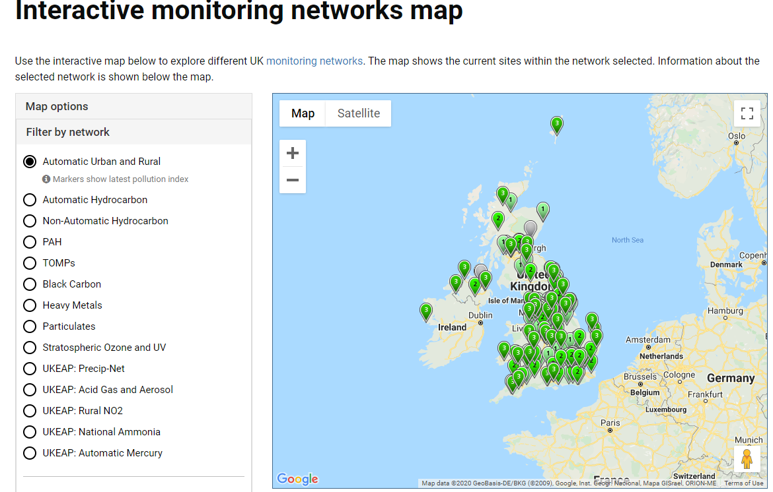

Slide 3
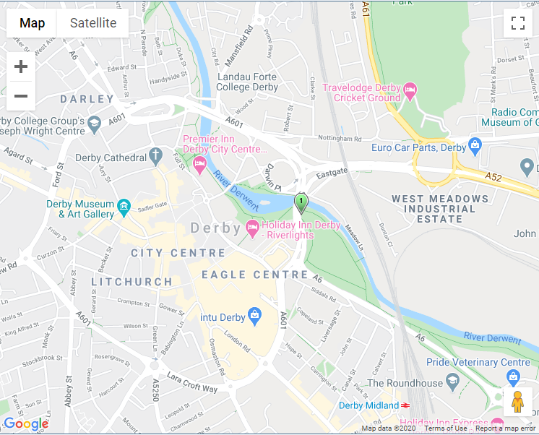
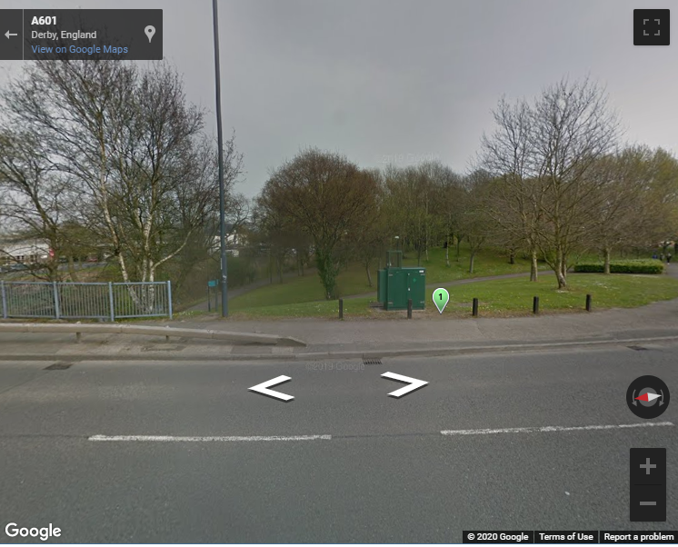

Slide 4
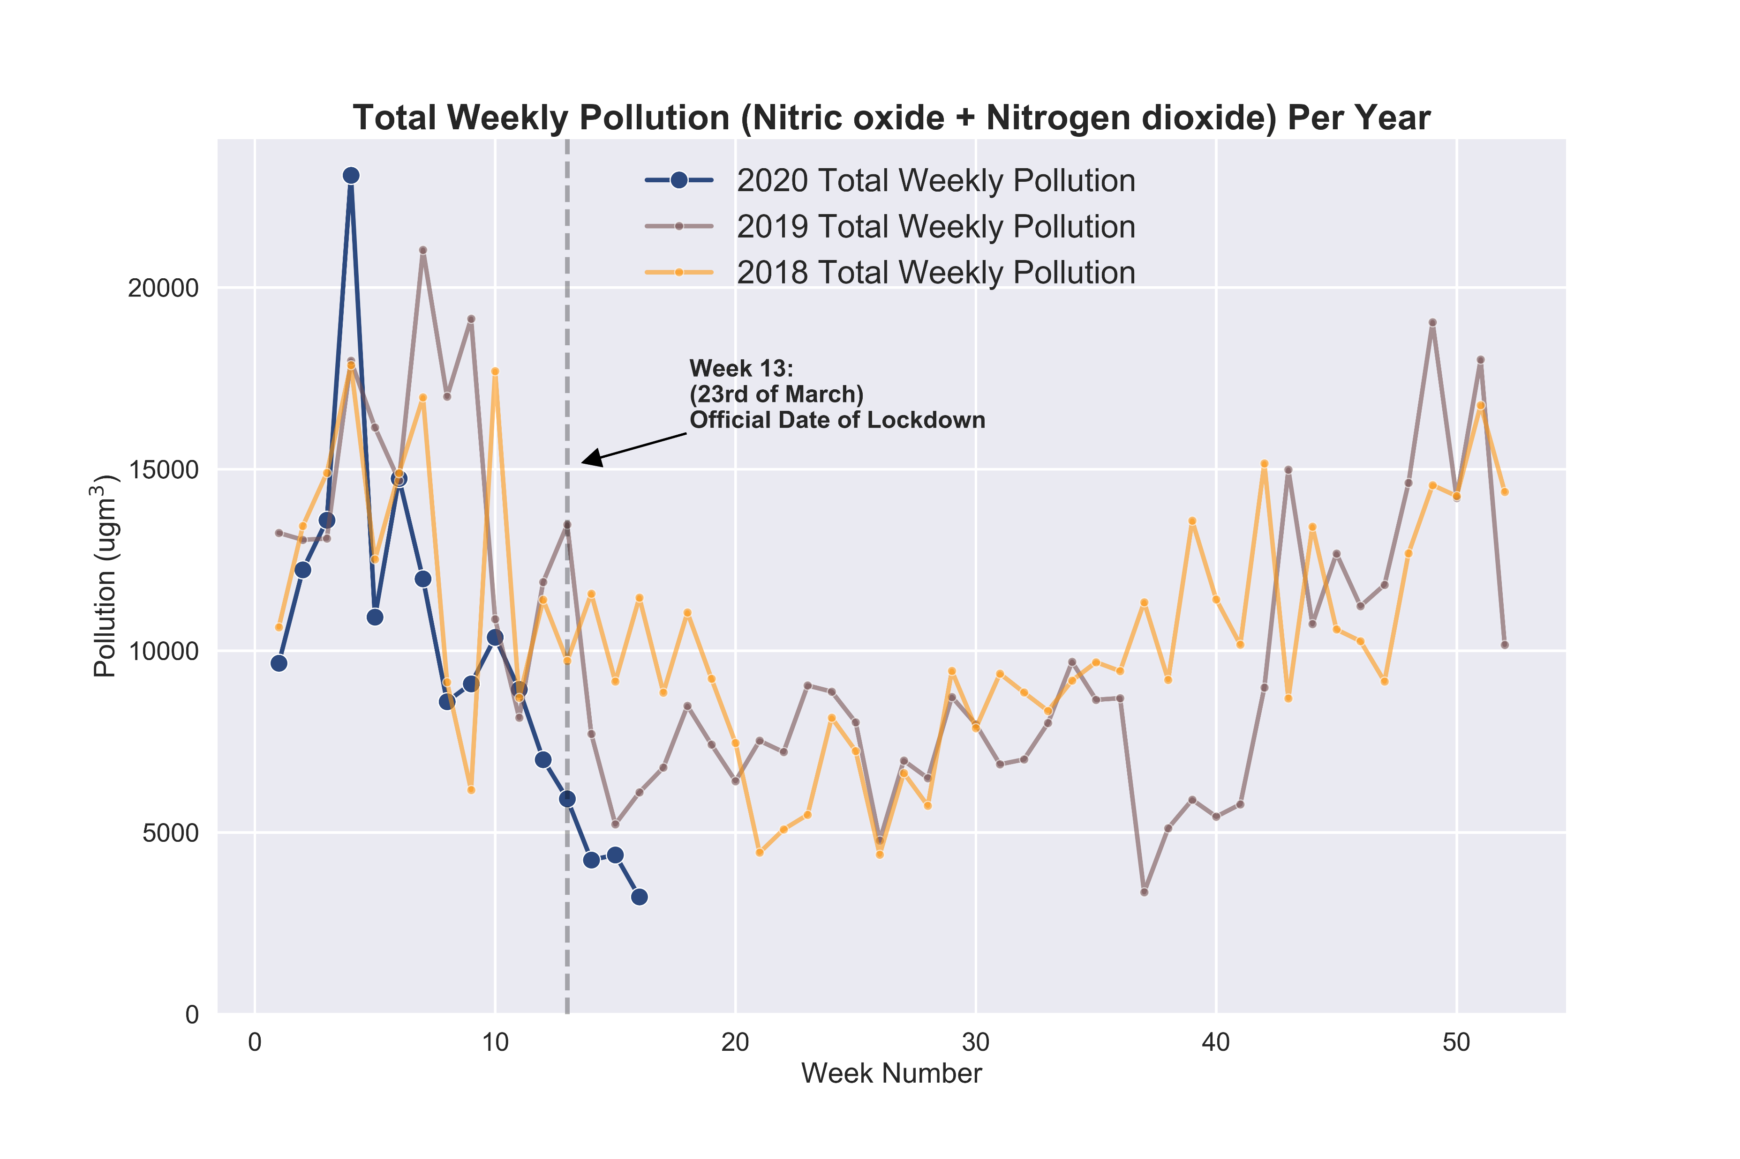
2020 compared to 2019 and 2018
Notes:
Commentary: note that pollution is clearly high in Q1 and Q4 and drops in Q2 and Q3

Slide 5
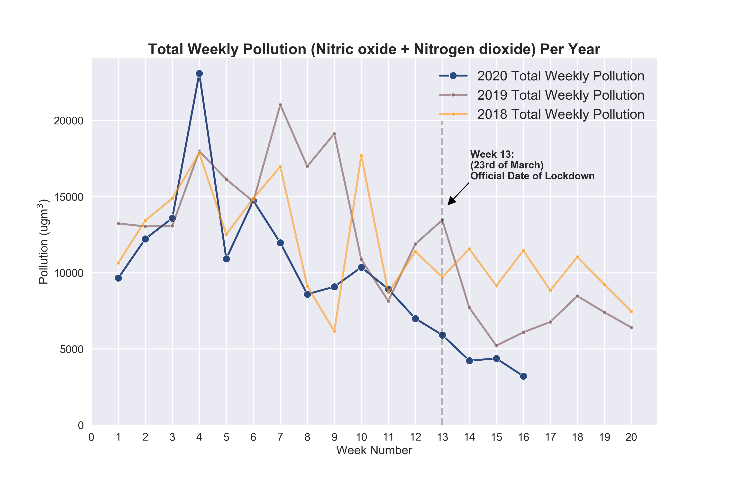
Previous graph but zoomed in

Slide 6
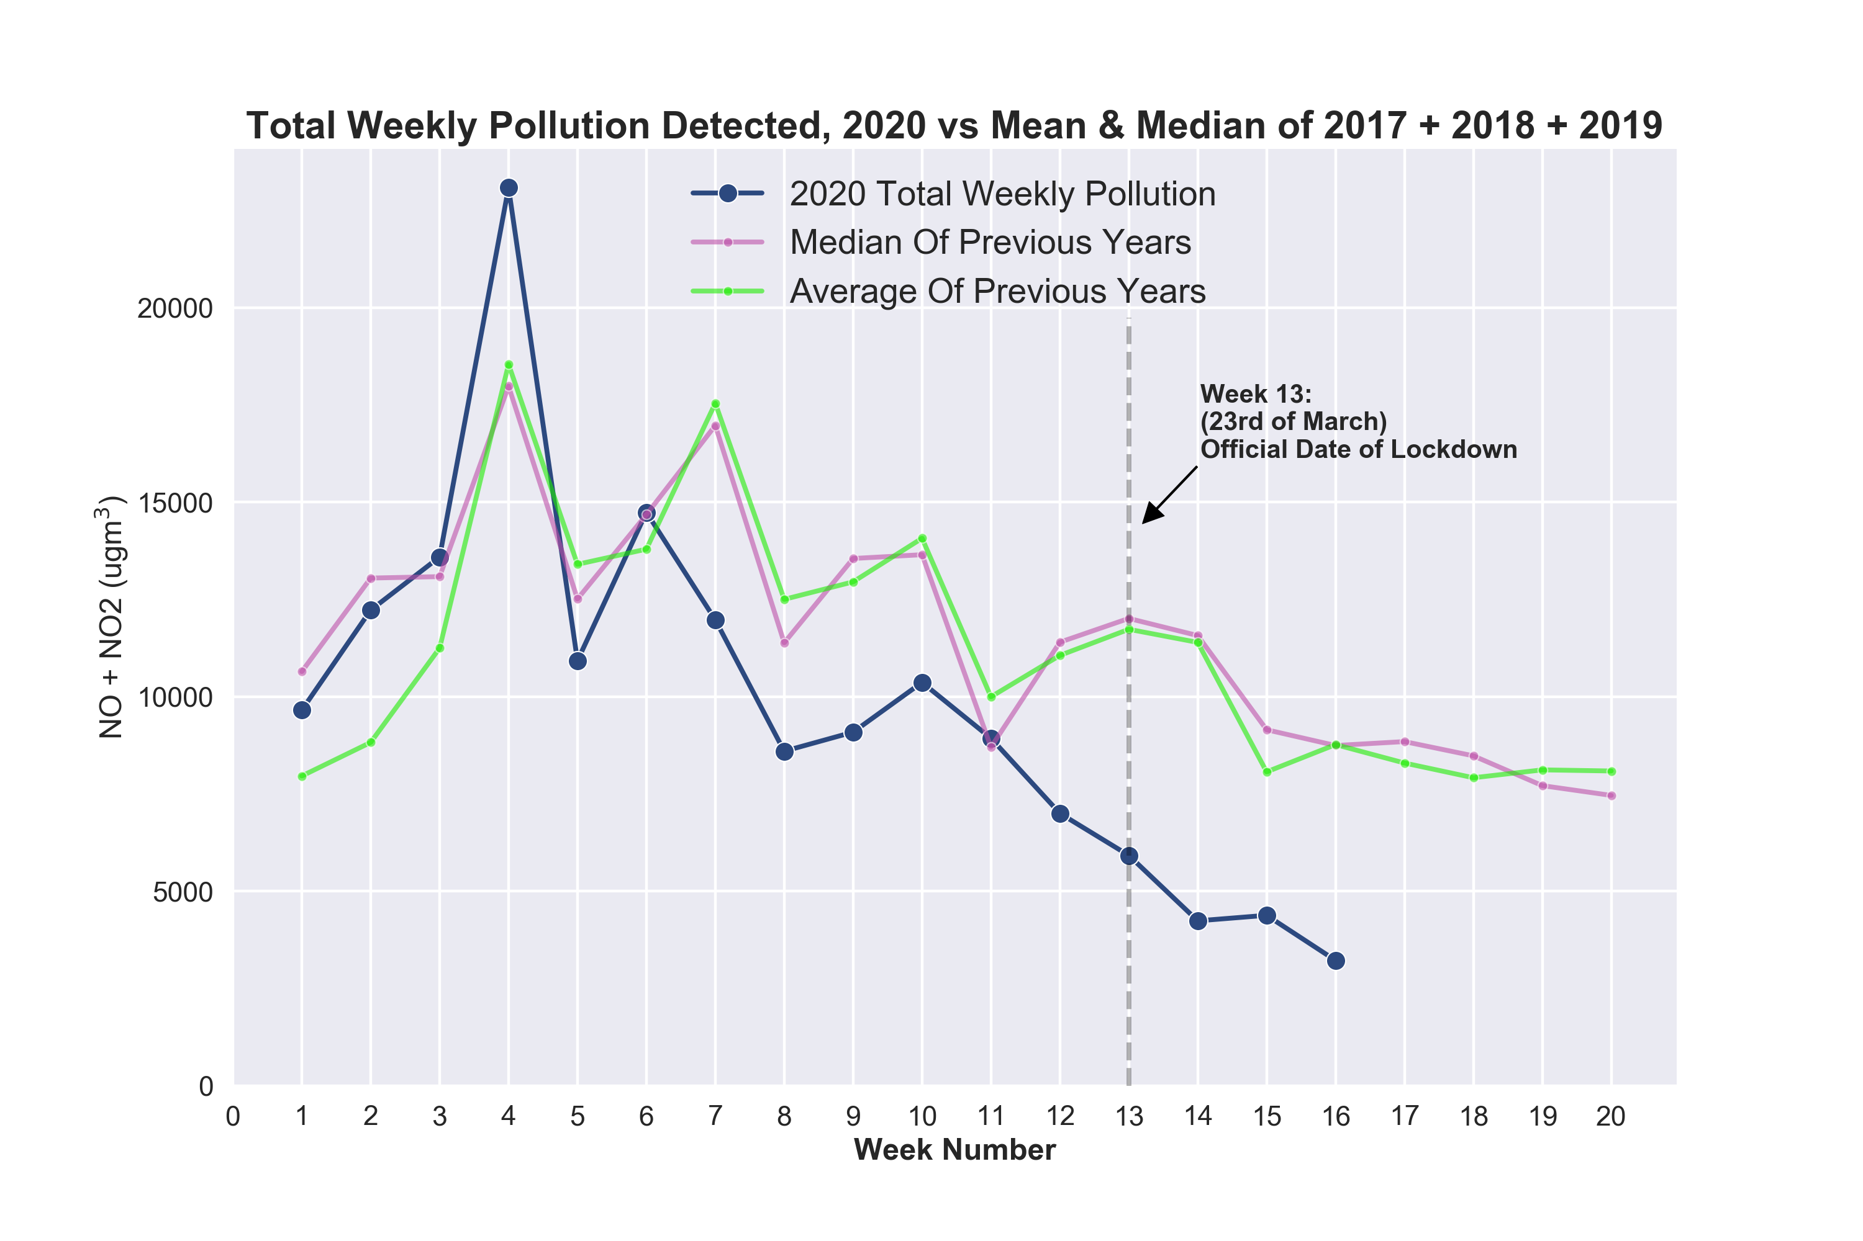
Comparing 2020 to median and mean of 2017 + 2018 + 2019 for a better idea of how this year is comparing to “normal”

Slide 7
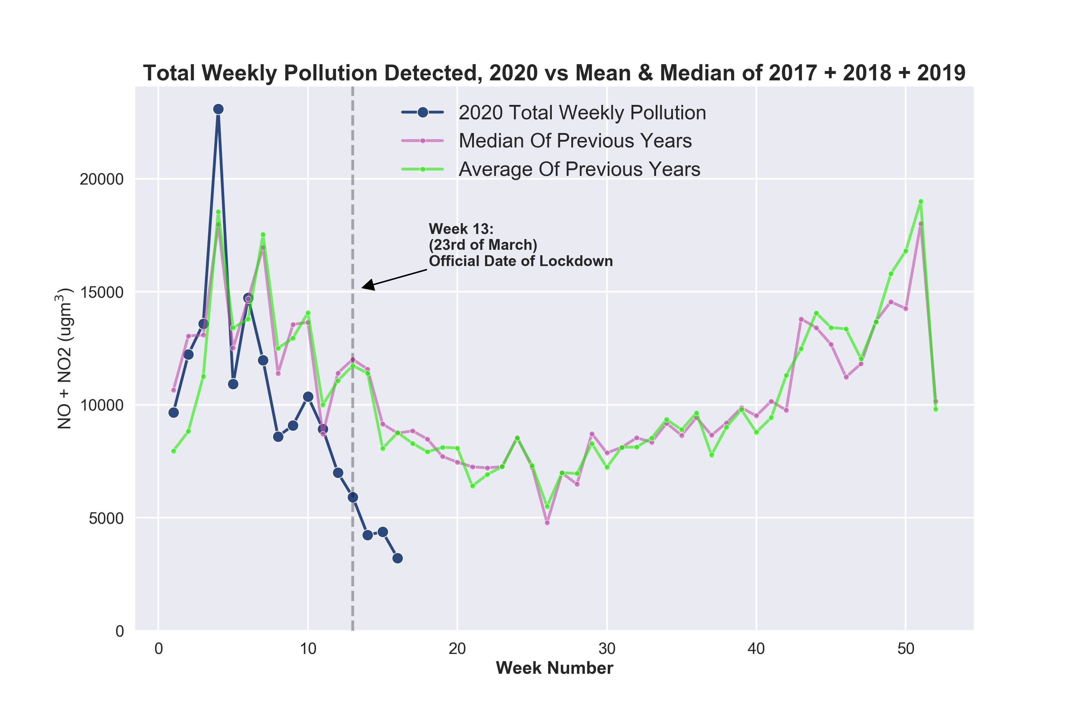

Slide 8
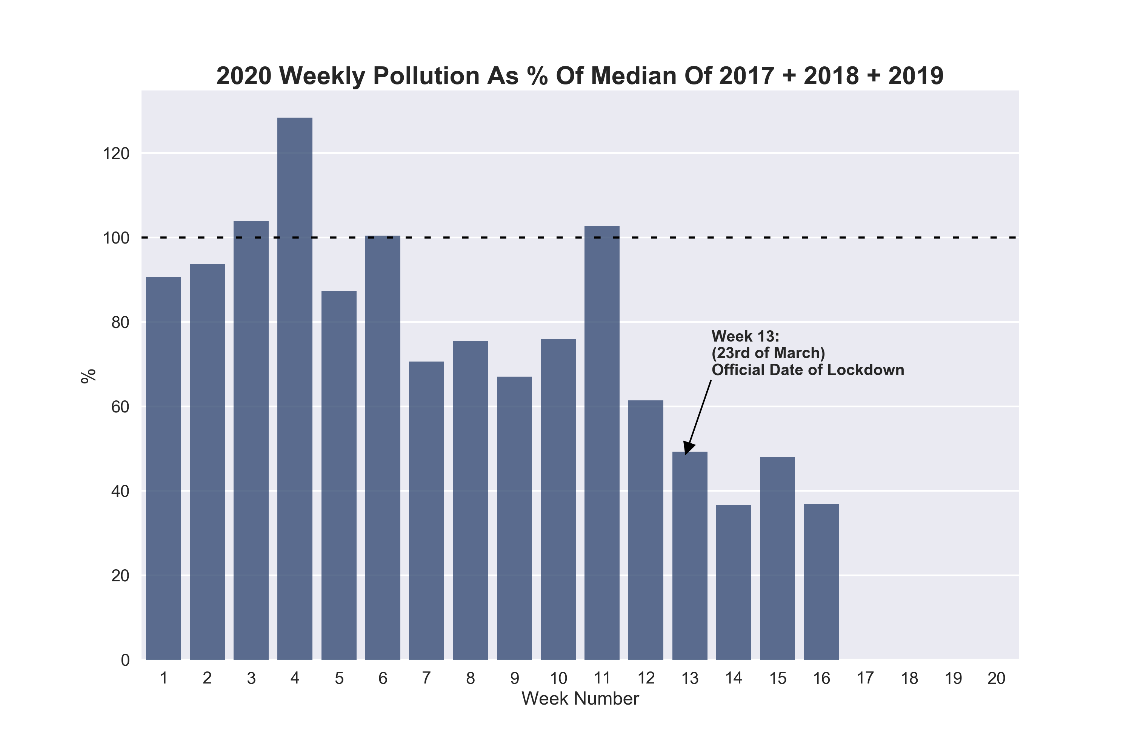
Similar to previous: asking “how is 2020 comparing to “normal” pollution levels measured in previous years?
Most weeks show pollution less than median (dashed line)

Slide 9
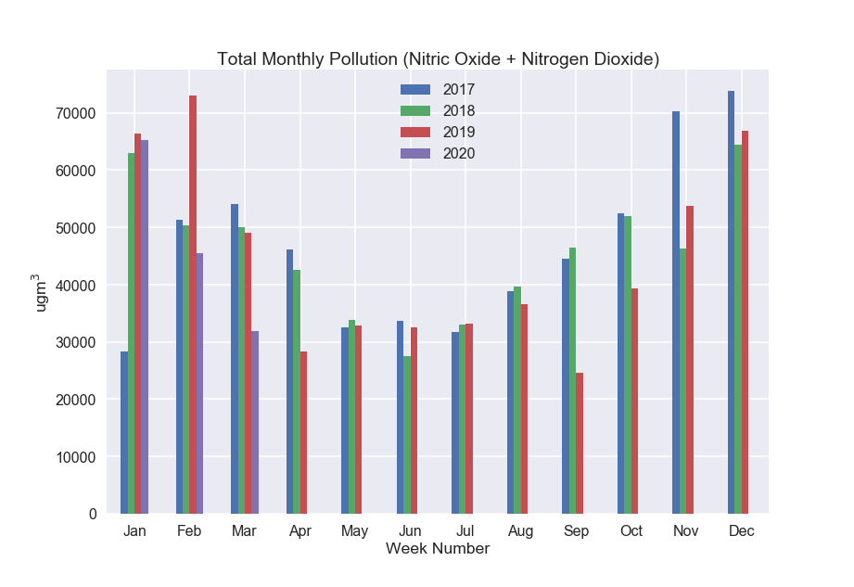
How each full month of 2020 compares to previous 3 years
Note Q1 and Q4 have high pollution, and pollution drops in Q2 and Q3

Slide 10
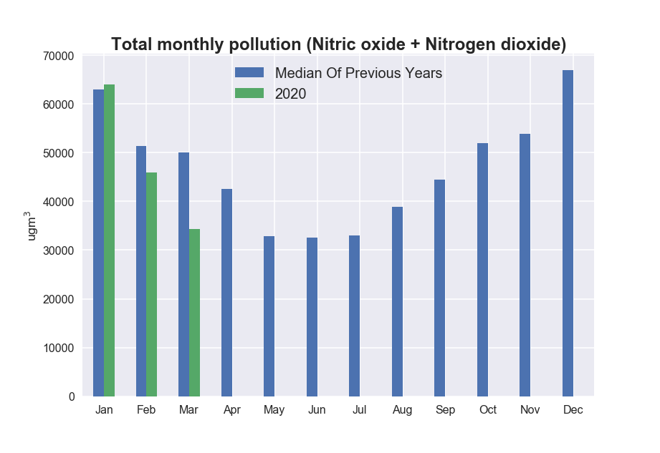

Slide 11
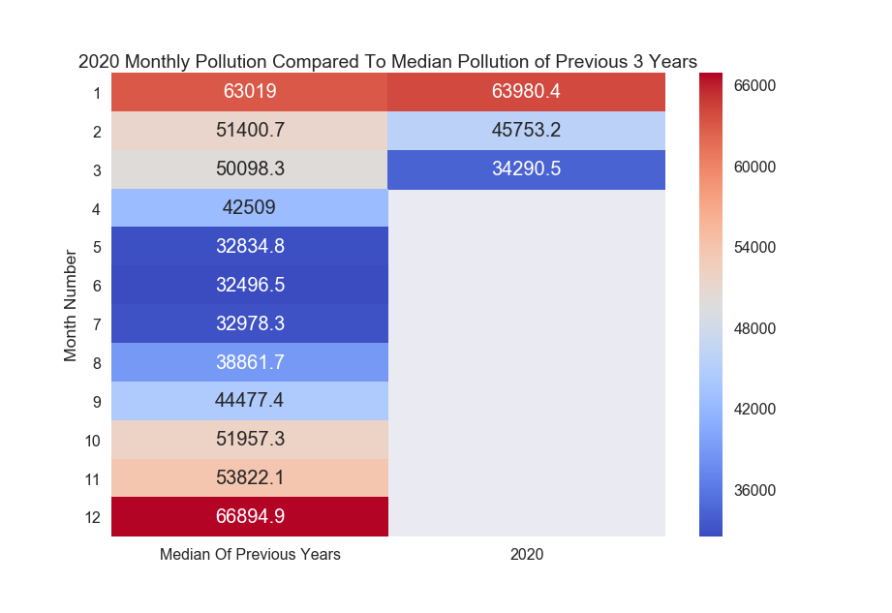
How each full month of 2020 compares to median of previous 3 years
March is significantly lower than median.
March 2020: 63.5% pollution of median of previous years i.e. 36.5% drop

Slide 12
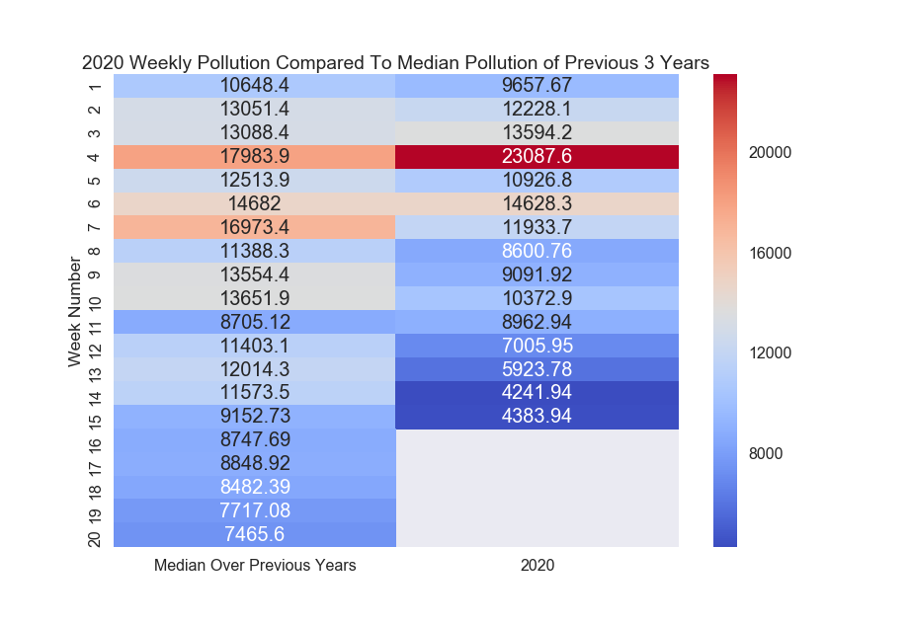
How each full week of 2020 compares to median of previous 3 years

Slide 13
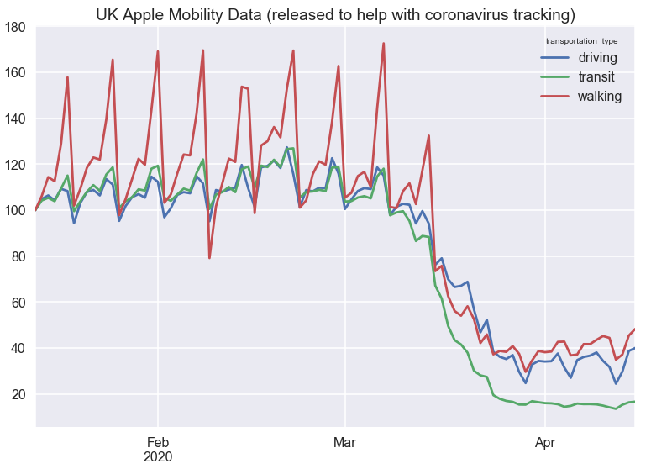

Slide 14
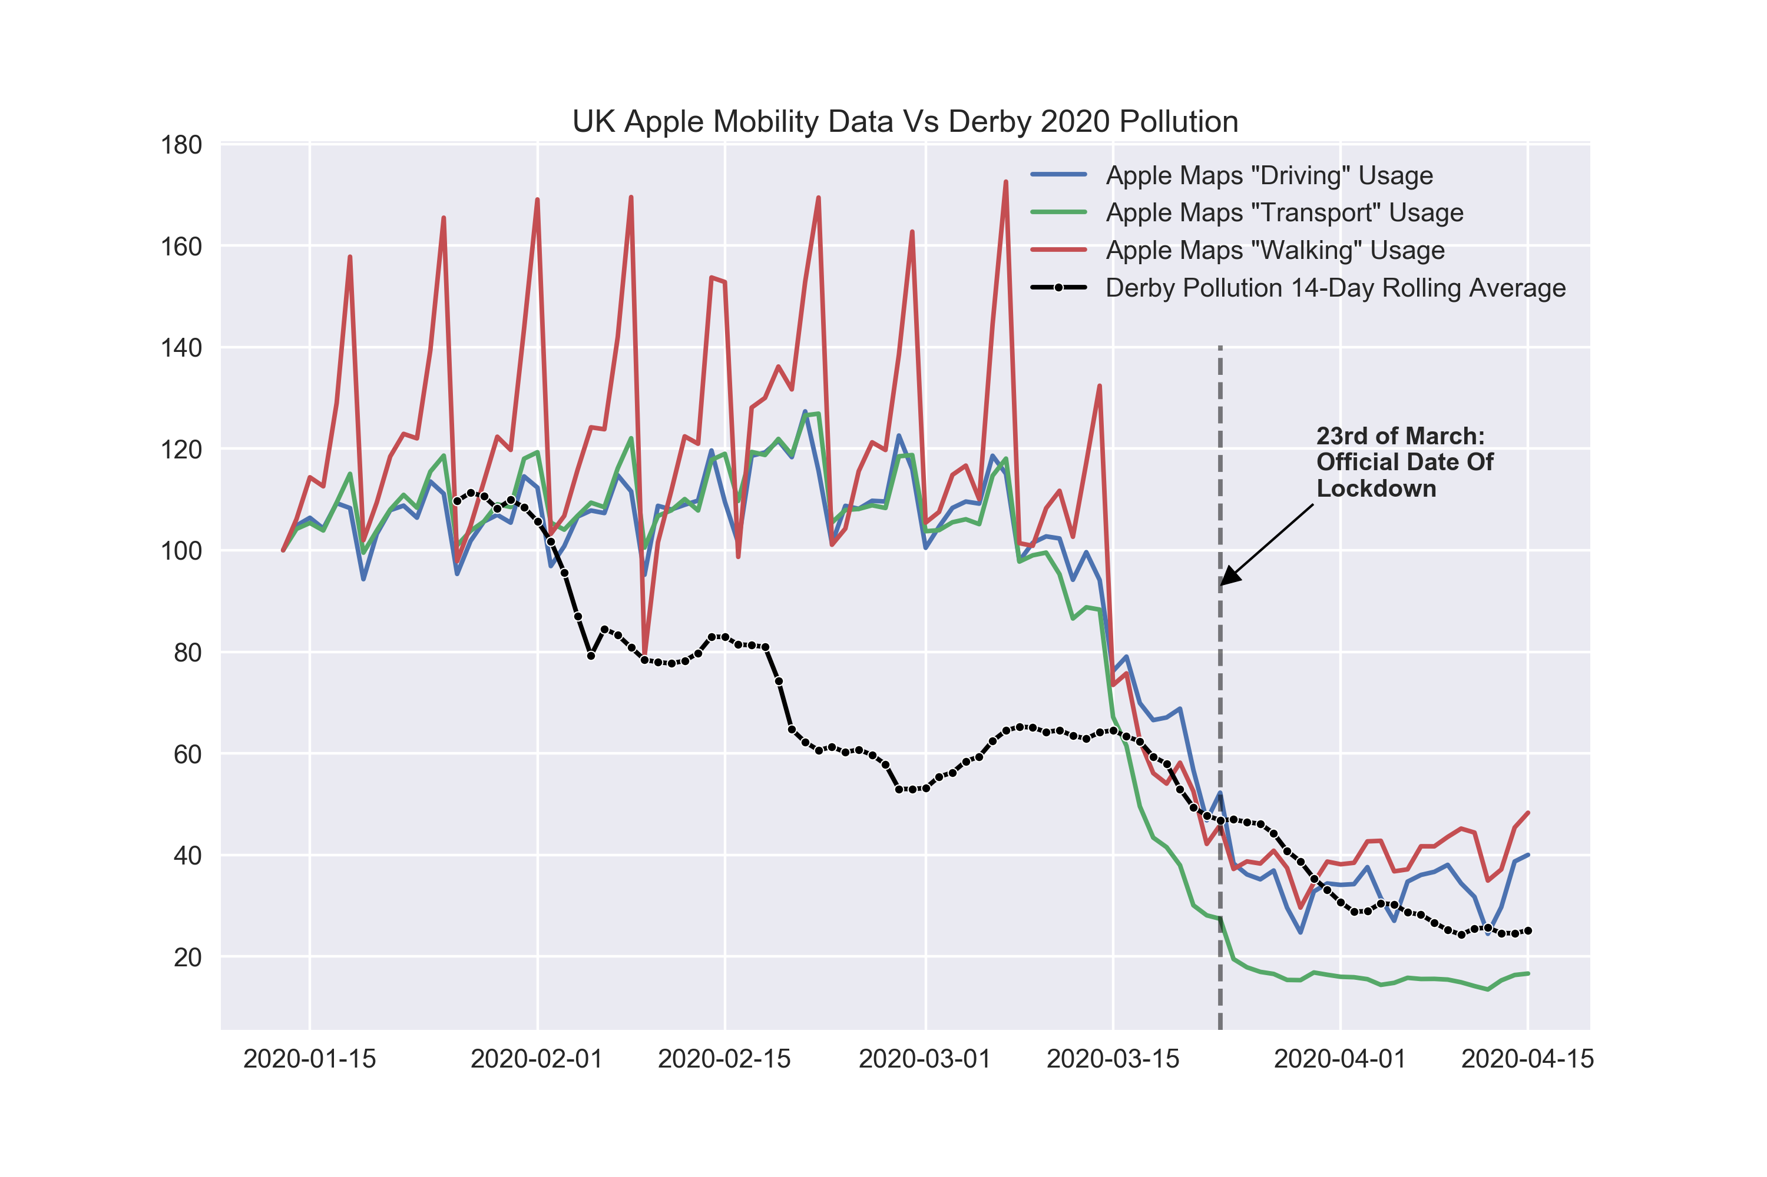
Daily Derby air pollution measured vs Apple Mobility data, which shows how much people are using Apple Maps
Derby air pollution dropped before official lockdown date and before Apple data (which is for whole of UK rather than specifically Derby) noted a change

Slide 15
Misc graphs to maybe include

Slide 16
